Slide 1
IFSM300: Information Systems in Organizations
Week 1
Introductions
Hybrid Class
Content on LEO
Saylor.org eBook
Week 1 Quiz
Week 1 Chapters
1 = What is an Information System?
7 = Does IT Matter?
Watch videos
Notes:
1
Students may not know exactly what is meant by globalization or may have an incomplete understanding of the term. You might ask students what they think it means. Potential answers could include: reduction of economic and cultural advantages of developed countries, increased number of companies with operations in multiple countries worldwide, and increased reliance on imports and exports of goods (and jobs). Globalization will be discussed in later slides as well.
The sociotechnical systems perspective holds that optimal organizational performance is achieved by jointly optimizing the social and technical systems used in production. This helps to avoid the mistaken idea that information systems consist of computers or technology alone. You could ask students at this point whether they feel that information systems are nothing more than technology, and revisit the point later in the chapter when the topic is discussed in more detail.

Slide 2
Chapter 1: What is an Information System?
Information Systems Technology consist of computer hardware, software, and data, that control processes for people
software
hardware
Processes People
data

Slide 3
Brief History of Computers
Mechanical Calculators increase speed and accuracy of numerical computations
Abacus over 5,000 years ago (+/-)
Adding machines and cash register (+/-) 1800’s
Slide rules (×/÷) 1800’s
Bomb sites and ballistic sites (×/÷/+/-) 1900’s
Electric Computers developed since 1945
ENIAC (Electronic Numerical Integrator and Calculator)
Weight 33 tons, power 175 kw, 17,000 vacuum tubes,
5k (+/-) per second, but sometimes hardware bugs
IBM sold 100’s of vacuum tube computers in 1950’s
Computers used for for business accounting and research
Machine Language and Assembly Language programs

Slide 4
Electronic Semi-Conductor Computers
AT&T developed Transistors 1950’s
AT&T developed computers for telephony switches
IBM and DEC computers (transistors) 1960’s
Mainframe Era
Microprocessors and Integrated Circuits
Personal Computing developed 1970s
Floppy disks and Hard drives
Commodore, Atari, Apple, IBM
Movie: Pirates of Silicon Valley
What computer devices do we use today?

Slide 5
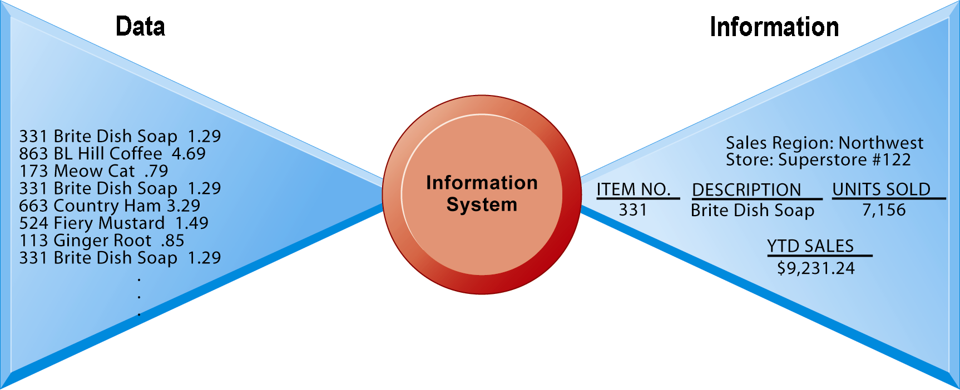
Perspectives on Information Systems
Information system:
Set of interrelated components (hardware and software)
Collect, process, store, and distribute information
Support decision making, coordination, and control
Raw data from a supermarket checkout counter can be processed and organized to produce information.
What are data sources that are used today?
Notes:
5
These are some basic background understandings needed for the course. A system refers to a set of components that work together (hopefully). Can students think of systems other than information systems? The point of an information system is to make sense out all the confusing data in the environment, and put the data into some kind of order. Information is an ordered set of data that you can understand and act on. If the students want to get a sense of raw data, show them a stock ticker on a Web financial site. Ask them to tell you what it means? Then show them the current value of the Dow Jones Industrial Index and the S&P 500, and its daily trend (or for that matter switch to a 1 year view of either of these indexes). Looking at the indexes students can quickly get a grasp of whether the market is up or down, and they could act on that information.
Emphasize the distinction between information and data. You could, for example, ask several students to list their ages and write the numbers on one side of the board – then you could calculate the average age of those students on the other side, oldest student, youngest student, and so forth, to illustrate the difference between raw data and meaningful information.

Slide 6
Activities of an Information System
Four activities produce information organizations need
Input: Captures data from organization & environment
Processing: Converts raw data into meaningful information
Output: Transfers information to people or activities for use
Feedback: Output returned to evaluate or correct input stage
An information system contains information about an organization and its surrounding environment.
Environmental actors
Customers
Suppliers
Competitors
Stockholders
Regulatory agencies
Notes:
6
Use an example similar to the one given in the previous slide to illustrate the three activities involved in the function of an information system. Continuing with that example, the process of asking students their age would represent input, calculating the average age and determining the oldest and youngest age would represent processing, and writing that information on the board would represent output.
Explain to students that the ‘house’ analogy runs as follows: assuming that a successful information system is like a completed ‘house’, computers and software only represent the tools and materials used to build the house. Tools and materials don’t just suddenly become a completed house – outside (human) input is required. Systems need to be designed to fit the firms and the humans who work with the systems.
The point of this diagram is first of all to highlight the three basic activities of information systems, so that students can understand what an information system is doing at its most fundamental level. But the diagram also puts information systems into the context of organizations (firms), and then puts the firm into its respective environment composed of shareholders, higher level authorities (government), competitors, suppliers and customers. Suddenly students should see that information systems play a central role mediating and interacting with all these players. Hence, systems play a key role in the operations and survival of the firm.
You could also explain this diagram by relating it back to the opening case, as the book does. The two types of input into the Synergy system are manually entered data as well as video. The system processes that data and creates the output, video and statistics about specific types of players and plays.

Slide 7
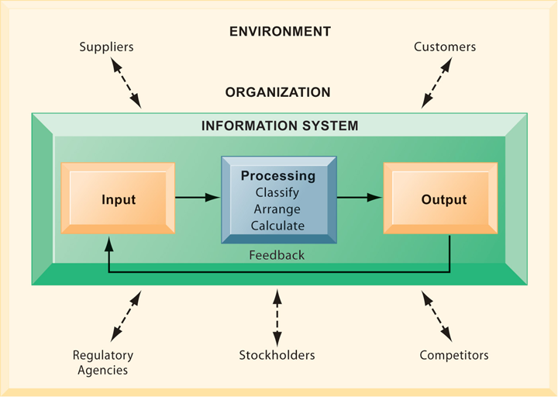
Interactions with Organization
Notes:
7
Use an example similar to the one given in the previous slide to illustrate the three activities involved in the function of an information system. Continuing with that example, the process of asking students their age would represent input, calculating the average age and determining the oldest and youngest age would represent processing, and writing that information on the board would represent output.
Explain to students that the ‘house’ analogy runs as follows: assuming that a successful information system is like a completed ‘house’, computers and software only represent the tools and materials used to build the house. Tools and materials don’t just suddenly become a completed house – outside (human) input is required. Systems need to be designed to fit the firms and the humans who work with the systems.
The point of this diagram is first of all to highlight the three basic activities of information systems, so that students can understand what an information system is doing at its most fundamental level. But the diagram also puts information systems into the context of organizations (firms), and then puts the firm into its respective environment composed of shareholders, higher level authorities (government), competitors, suppliers and customers. Suddenly students should see that information systems play a central role mediating and interacting with all these players. Hence, systems play a key role in the operations and survival of the firm.
You could also explain this diagram by relating it back to the opening case, as the book does. The two types of input into the Synergy system are manually entered data as well as video. The system processes that data and creates the output, video and statistics about specific types of players and plays.

Slide 8
Role of Information Systems in Business
Information systems is transforming business
Mobile Digital Platforms using wireless technology
Internet, World Wide Web, and E-commerce
Cloud Computing business software uses Internet
Shifts in media and advertising to WWW, google.com
Web 2.0 enables networked computing, zoho.com
It provides opportunities for Completive Advantage
Globalization opportunities
Internet enables operating business on global scale
In the emerging, fully digital business firm
Relationships are digitally enabled and mediated
Data connectivity achieved using digital networks
Time shifting (24/7) and Space shifting (global)
Notes:
8
New federal security and accounting laws that require companies to store e-mail for 5 years have spurred the growth of digital information, which is increasing at a rate of 5 exabytes annually. Students may be surprised to learn that 5 exabytes of data is equivalent to 37,000 Libraries of Congress. Ask the students to think about what difference it makes to the world economy, or the U.S. economy, if global operations become much less expensive? What are the challenges to American suppliers of goods and services, and to labor?
Time shifting and space shifting are connected to globalization. You could ask students to explain why a digital firm is more likely to benefit from globalization than a traditional firm; the right idea is that by allowing business to be conducted at any time (time shifting) and any place (space shifting), digital firms are ideally suited for global operations which take place in remote locations and very different time zones.

Slide 9
Information Systems Business Examples
Walmart’s RetailLink system links suppliers to stores for superior replenishment system
Amazon’s Warehouse IT robotic assistant system links suppliers to stores
Synergy Sports Technology tags game video with descriptive categories and allows coaches and players to stream game footage from Web
Problem: Lack of hard data usable in decision-making processes in competitive basketball
Solutions: Developed a new system designed to collect and organize data using game video clips
Notes:
9
Ask students to predict whether an NBA team using Synergy Sports Technology would be more successful than a team that did not use the service. Prompt them to explain why they feel the way they do. You could also ask whether or not they would expect an organization like a professional sports franchise to be a good example of the importance of information systems. The point here would be that information systems are vitally important to all forms of business, professional sports included.

Slide 10
Chapter 7: Does IT Matter?
Organizations have spent trillions of dollars on IT. Has this investment made a difference?
The Productivity Paradox 1991 Mismeasurement of outputs and inputs
Lags due to learning and adjustment
Redistribution and dissipation of profits
Mismanagement of information and technology
Does IT Matter? By Nicholas Carr 2003 Manage as commodity: Low cost and low risk
Firm should never be first to try a new technology
Letting others take the risks
Goal is best service with minimal downtime

Slide 11
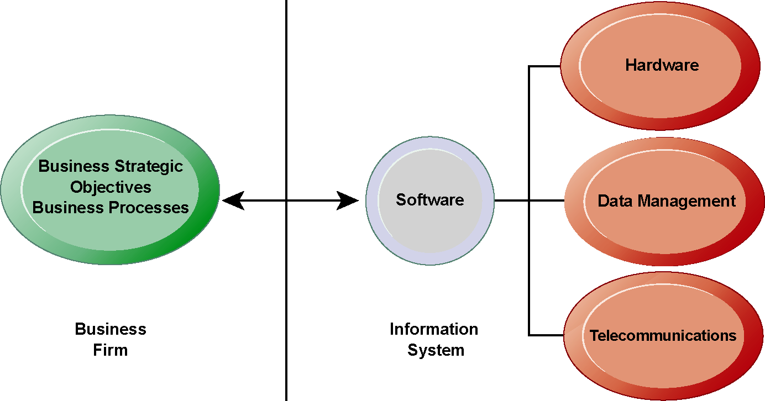
IT Should Enable Corporate Strategy & Goals
The Interdependence Between Organizations and Information Technology
Notes:
11
The basic point of this graphic is that in order to achieve its business objectives, a firm will need a significant investment in IT. Going the other direction (from right to left), having a significant IT platform can lead to changes in business objectives and strategies.
Emphasize the two-way nature of this relationship. Businesses rely on information systems to help them achieve their goals; a business without adequate information systems will inevitably fall short. But information systems are also products of the businesses that use them. Businesses shape their information systems and information systems shape businesses.
In contemporary systems there is a growing interdependence between a firm’s information systems
and its business capabilities. Changes in strategy, rules, and business processes increasingly require changes in hardware, software, databases, and telecommunications. Often, what the organization would like to do depends on what its systems will permit it to do.

Slide 12
Porter’s Value Chain Model
Michael Porter on Competitive Advantage
Cost Advantage
Differentiation Advantage
Notes:
IT figures to replace the function of more middle managers as time passes, as well as reduce the need for other forms of capital (buildings, machinery). Ensure that students understand what is meant by ‘economics of information’ and why outsourcing is a possibility due to IT.

Slide 13
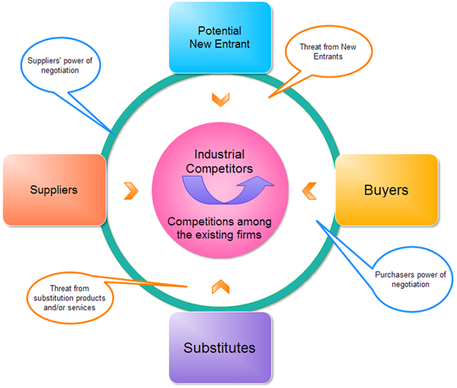


Porter’s 5 Forces Model
Who is the big winner from IT?
Consumers
Cost Advantage
Differentiation Advantage
Notes:
IT figures to replace the function of more middle managers as time passes, as well as reduce the need for other forms of capital (buildings, machinery). Ensure that students understand what is meant by ‘economics of information’ and why outsourcing is a possibility due to IT.

Slide 14
Generic Strategies for Competitive Forces
Low-cost leadership
Produce products at a lower price and better quality Wal-Mart, Dell
Product differentiation
New products, improve customer experience: Google, Land’s End, Apple
Focus on market niche
Use information systems to enable a focused strategy on a single market niche and specialize
Strengthen customer and supplier intimacy
Develop strong ties and loyalty with customers and suppliers; increase switching costs
Example: Amazon, PayPal
Notes:
Here you can make a list of five well-known firms and then analyze with students the major thrust of their strategy. Wal-Mart is a good example to start with because of its emphasis on low-cost leadership.
Do students believe it is possible both to design information systems that focus both on low-cost leadership and product differentiation? Some may say it is with sufficient planning and innovation; perhaps a new product is even cheaper to produce than older ones. Some may say that the investment in innovation required for product differentiation precludes that firm from maintaining low-cost leadership.
You could ask students to provide other examples from their own experience of companies that exemplify strong focus on market niche as well as excellent customer and supplier intimacy.

Slide 15
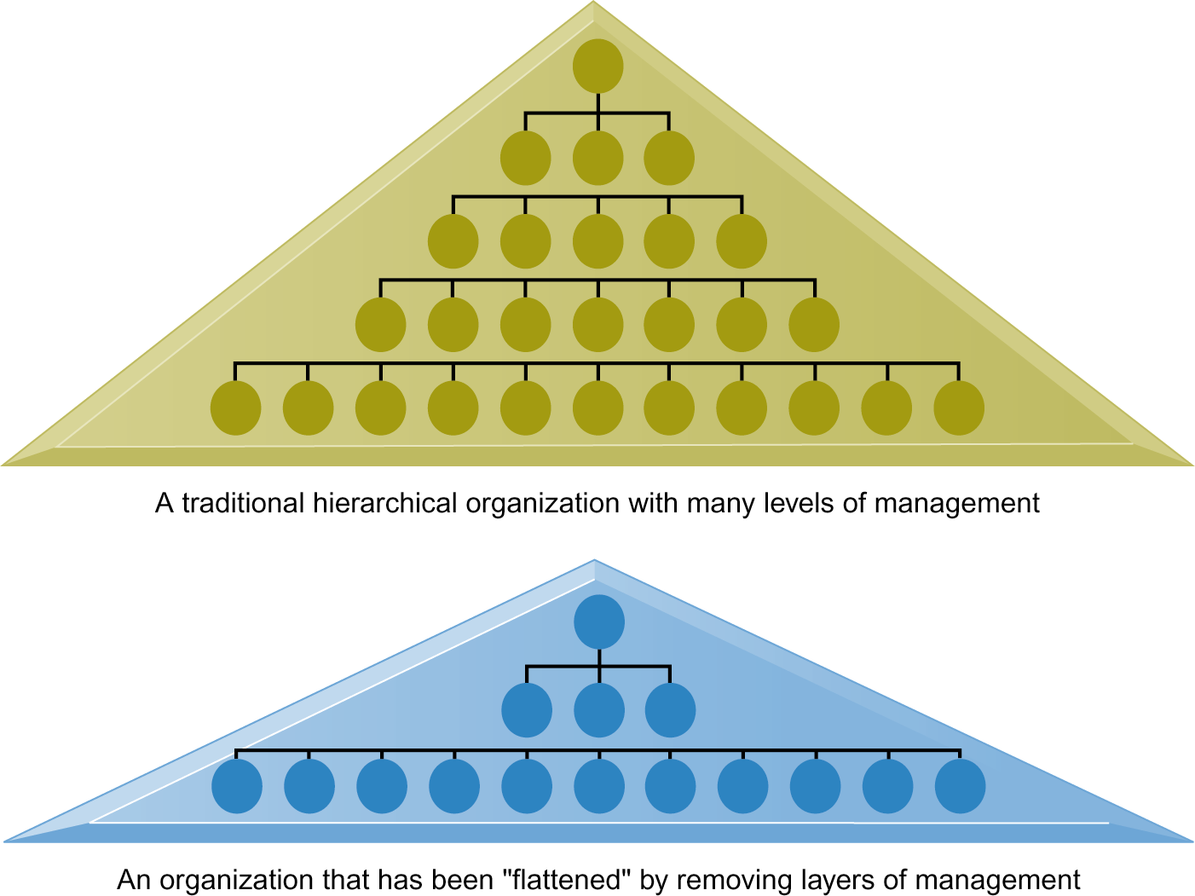
Business Process Management Systems
Information systems can reduce the number of levels in an organization
Provide managers with information to supervise larger numbers of workers
Gives lower-level employees more decision-making authority
Post-industrial Society authority relies on knowledge then position
Notes:
Ask students to explain some of the benefits of the flattened organization as opposed to the more complicated hierarchy. Information travels through fewer levels to its intended recipients, fewer managers so agency costs are smaller, and firms can act faster (less decision delay).
Ask students to explain what is meant by authority relying on knowledge and competence rather than formal positions. Why might this ‘flatten’ and organization? The idea here is that with sufficient IT, competent workers will be able to accomplish more on their own than they would under a more concrete hierarchy.

Slide 16
E-Commerce: New Efficiencies B2B
Electronic Data Interchange (EDI)
Computer-to-computer exchange of standard transactions such as invoices, purchase orders
Notes:
This slide looks at changes brought to B2B e-commerce by Internet technologies. Note that the Internet and Web technology enable businesses to create new electronic storefronts for selling to other businesses with multimedia graphic displays and interactive features similar to those for B2C commerce. Alternatively, businesses can use Internet technology to create extranets or electronic marketplaces for linking to other businesses for purchase and sale transactions.
This slide continues the discussion of ways the Internet and Web technologies have changed B2B e-commerce. One way is in using an extranet to link to the firm’s suppliers. The text provides the example of VW Group Supply, which links the Volkswagen Group and its suppliers. VW Group Supply handles 90 percent of all global purchasing for Volkswagen, including all automotive and parts components.
This slide continues the discussion of ways the Internet and Web technologies have changed B2B e-commerce, in this case by the ability to create Net marketplaces. Ask students to distinguish between and provide examples of direct and indirect goods. (Direct goods are goods used in a production process, such as sheet steel for auto body production. Indirect goods are all other goods not directly involved in the production process, such as office supplies or products for maintenance and repair.)
Ask students to distinguish between vertical and horizontal marketplaces.
16

Slide 17
E-Commerce: New Efficiencies B2B
Collaborative Systems
Cloud Storage: Document sharing and backup Dropbox, Google Drive, iCloud, GitHub,
Sharepoint and Lotus Notes
Email asynchronous
Teleconference synchronous: Skype, WebEx, Zoom
Browser based Web apps: Google docs and Zoho
Net marketplaces (e-hubs)
Single market for many buyers and sellers
Generate revenue from transaction fees
Use prices established through negotiation, auction, Request For Quotes, or fixed prices
Long-term contract or short-term spot purchasing
Notes:
This slide looks at changes brought to B2B e-commerce by Internet technologies. Note that the Internet and Web technology enable businesses to create new electronic storefronts for selling to other businesses with multimedia graphic displays and interactive features similar to those for B2C commerce. Alternatively, businesses can use Internet technology to create extranets or electronic marketplaces for linking to other businesses for purchase and sale transactions.
This slide continues the discussion of ways the Internet and Web technologies have changed B2B e-commerce. One way is in using an extranet to link to the firm’s suppliers. The text provides the example of VW Group Supply, which links the Volkswagen Group and its suppliers. VW Group Supply handles 90 percent of all global purchasing for Volkswagen, including all automotive and parts components.
This slide continues the discussion of ways the Internet and Web technologies have changed B2B e-commerce, in this case by the ability to create Net marketplaces. Ask students to distinguish between and provide examples of direct and indirect goods. (Direct goods are goods used in a production process, such as sheet steel for auto body production. Indirect goods are all other goods not directly involved in the production process, such as office supplies or products for maintenance and repair.)
Ask students to distinguish between vertical and horizontal marketplaces.
17

Slide 18
Decision Support Systems
Supports decision making process
Can Serve all levels of management
Customer Service Management
Supports unstructured non-routine decisions
Labor or Legal issues
May involve unknowns
Managers may use intuition
Semi-structured decisions
Most factors known, but human experience helpful
Investment decisions
Medical Watson Health www.isabelhealthcare.com
Highly structured decisions can be automated
Inventory management
Robotic automation

Slide 19
The Internet and Organizations
The Internet increases the accessibility, storage, and distribution of information and knowledge for organizations
The Internet can greatly lower transaction and agency costs
Customer service
Marketing
The Internet’s impact on competitive advantage
Transformation, destruction to some industries
Competitive forces, but rivalry more intense
Universal standards allow new rivals
New opportunities for building brands and loyalty
Empowers customers
Notes:
The Internet should also have a flattening effect on many organizations. Can students describe any businesses that have become more efficient and flat thanks to successful incorporation of the Internet in their operations? Some older students may remember the “bad old days” when seven or more levels of management needed to decide even simple issues in a typical firm.
Do students believe it is easier or harder to gain a competitive advantage via the Internet as opposed to more traditional means? Table 3-5 describes the impact of the Internet on various competitive forces.

Slide 20
Videos to View
Walmart IT History https://youtu.be/b5K1yrICMII
Amazon IT https://youtu.be/UtBa9yVZBJM
The Productivity Paradox 1991 http://ccs.mit.edu/papers/CCSWP130/ccswp130.html
Does IT Matter? https://youtu.be/hj_mzU3N70g
Value Chain https://youtu.be/Ul_kXIFdwQE
5 Force Model youtu.be/ZWQMwnCFIj0
EDI https://youtu.be/jV7okF2MVxI
DSS Health https://youtu.be/ZPXCF5e1_HI

